Slide 1
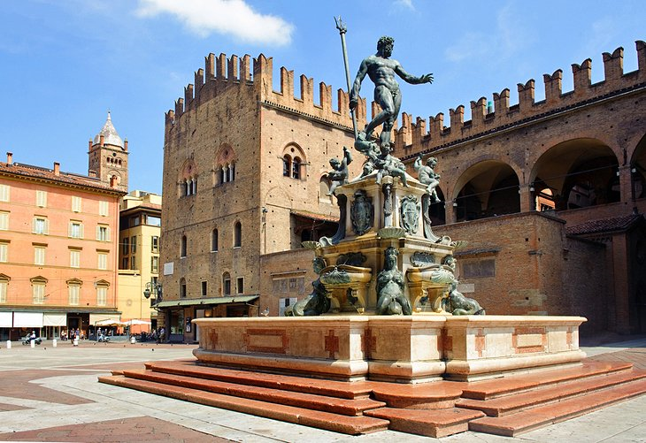
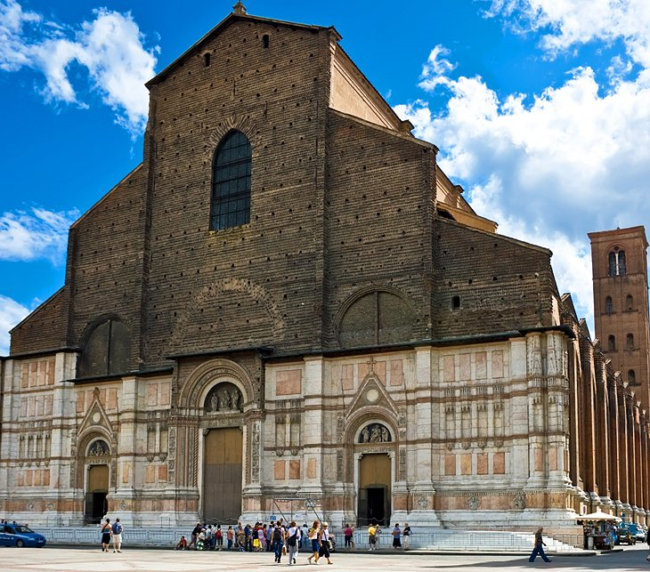
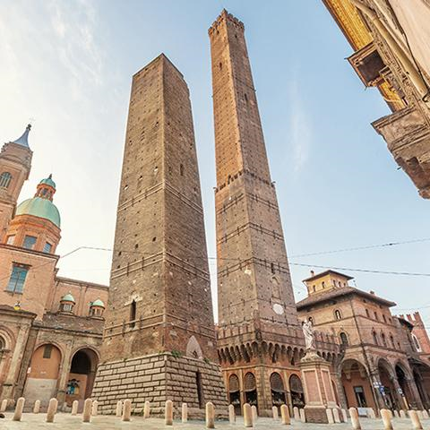
3 Attractions in Bologna!
Basilica of Saint Petronio , Piazza Maggiore , Leaning towers

Slide 2
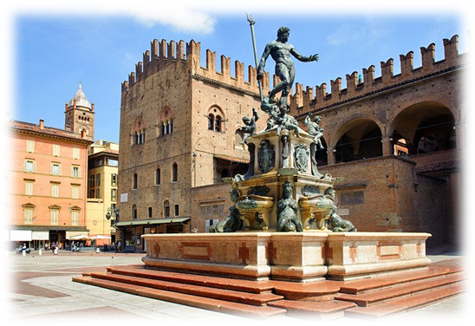
PIAZZA MAGGIORE E PIAZZA DEL NETTUNO
Conversation and laughter blend with the sound of water splashing in the magnificent Neptune Fountain that gives Piazza del Nettuno its name. Created by Giambologna in the 16th century, it is one of the finest fountains of its period. Nearly every major attraction in the city is within a few minutes' walk, and the most important streets - among them the busy shopping street, Via dell'Indipendenza, and Via Galleria with its many old aristocratic mansions.

Slide 3
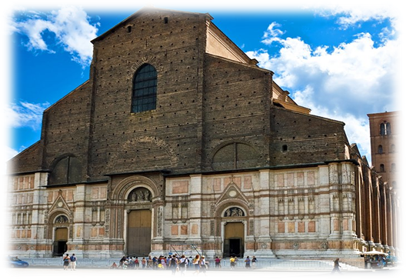
BASILICA OF SAINT PATRONIO
When construction of the massive church that dominates one side of Piazza Maggiore began in 1390, it was designed to be even bigger than St. Peter's in Rome, but never quite made it. In fact, it was never finished, and the facade remains incomplete. In the tiny museum at the back of the church, you can see the designs that were submitted for the facade, including those by the great architect Andrea Palladio. The interior, which was finished, is often referred to as the epitome of Gothic architecture in Italy, and each of the side chapels seems like a small church. Look for the strange line cutting across the floor of the nave; it is a meridian line.

Slide 4
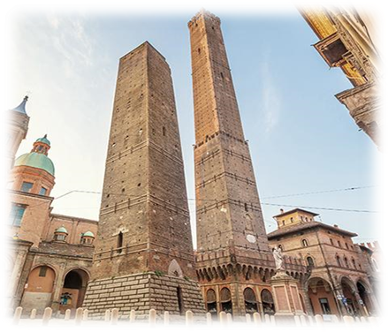
LEANING TOWERS
Bologna has a pair of towers that appear to tilt even more alarmingly because of their narrow shape. They are the best-known of the 20 towers that remain of the more than 100 that formed Bologna's 12th-century skyline. Although they were necessary as both watchtowers and places of refuge in case of attack, their height also became status symbols for the noble families that built them. The 48-meter Torre Garisenda leans by more than 13 meters; you can climb the 498 steps inside Torre degli Asinelli for birds-eye views of Bologna.

