Slide 1
Anna Frank

Slide 2
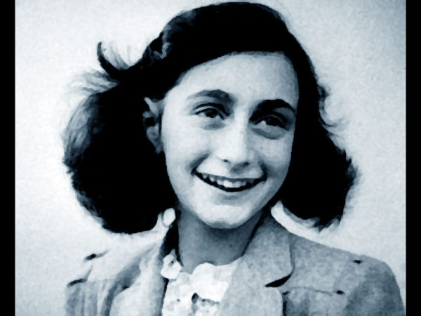
Annes first years
Anne Frank was born in the German city of Frankfurt am Main in 1929. Anne’s sister Margot was three years her senior. Unemployment was high and poverty was severe in Germany, and it was the period in which Adolf Hitler and his party were gaining more and more supporters. Hitler hated the Jews and blamed them for the problems in the country. He took advantage of the rampant antisemitic sentiments in Germany. The hatred of Jews and the poor economic situation made Anne's parents, Otto and Edith Frank, decide to move to Amsterdam. There, Otto founded a company that traded in pectin, a gelling agent for making jam.

Slide 3
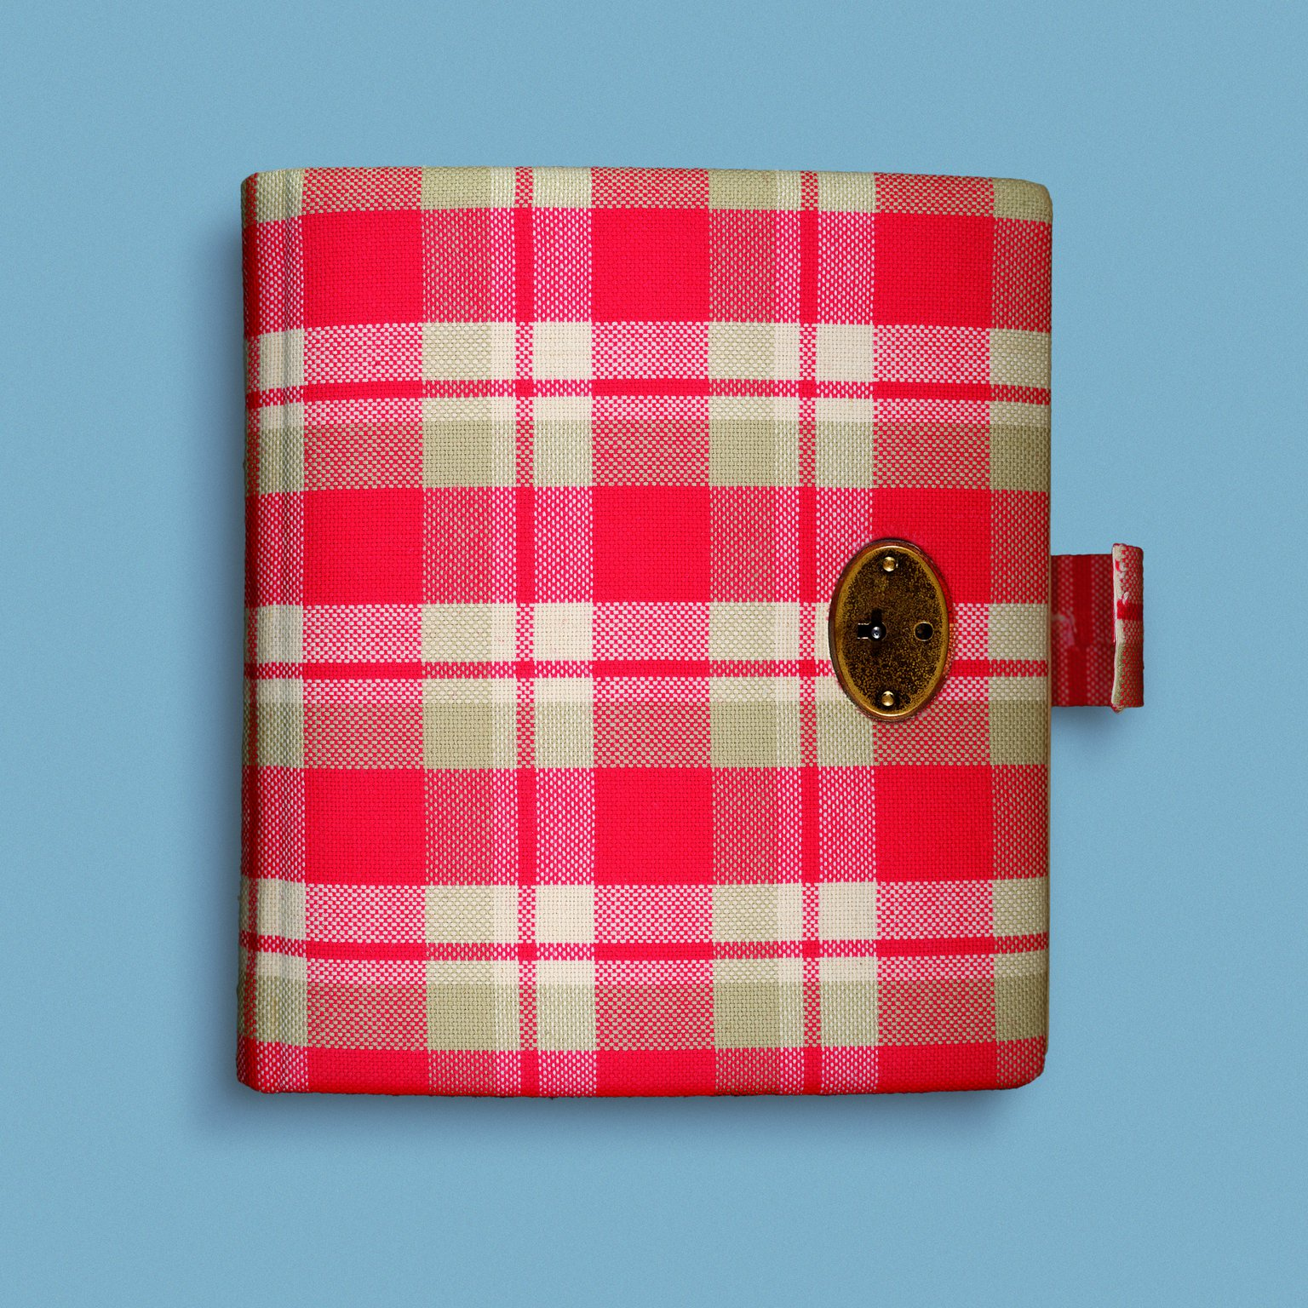
Anne keeps a diary
On her thirteenth birthday, just before they went into hiding, Anne was presented with a diary. During the two years in hiding, Anne wrote about events in the Secret Annex, but also about her feelings and thoughts. In addition, she wrote short stories, started on a novel and copied passages from the books she read in her Book of Beautiful Sentences. Writing helped her pass the time. When the Minister of Education of the Dutch government in England made an appeal on Radio Orange to hold on to war diaries and documents, Anne was inspired to rewrite her individual diaries into one running story, titled Het Achterhuis (The Secret Annex).

Slide 4
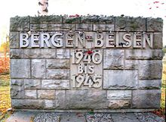
Anne is deported to Auschwitz and dies from exhaustion in Bergen-Belsen
In early November 1944, Anne was put on transport again. She was deported to the Bergen-Belsen concentration camp with Margot. Their parents stayed behind in Auschwitz. The conditions in Bergen-Belsen were horrible too. There was a lack of food, it was cold, wet and there were contagious diseases. Anne and Margot contracted typhus. In February 1945 they both died owing to its effects, Margot first, Anne shortly afterwards.

Slide 5
Anna Frank House and Museum
The Anne Frank House is a museum with a story. As a visitor, you experience this story through quotes, photos, videos, and original items. The atmosphere in the museum is authentic and subdued.
Anne Frank’s room :Anne had to share a room with Fritz Pfeffer, which led to frequent arguments. Not being able to go outside was hard for her. Her diary was a place to vent. To brighten up the room, Anne put pictures on the wall.
Diary room : here you can see the original red-checked diary Anne Frank received for her 13th birthday on 12 June 1942. A few weeks later, the Frank family had to go into hiding. Once in the Secret Annex, it was not long before Anne had filled her diary, and she continued writing in notebooks.
The collection of the Anne Frank House consists of around 15,000 documents and artefacts. They tell the story of Anne Frank, her diary and the Secret Annex. We can’t display everything in the collection, but the exhibition gives a good impression of its diversity.
Reflections is a continuous film, showing various people who talk about what Anne Frank means to them. See the exhibition and reflect on what Anne Frank means to you.

Slide 6
Tickets :
Entrance fees
Adults 10,50€
aged 10-17 5,50€
aged 0-9 0,50€
* including € 0.50 booking fee
Opening hours
1 April - 1 November: daily from 09:00 to 22:00
30 May - 1 September: daily from 8:30 to 22:00
1 November - 1 April: daily from 09:00 to 19:00
Saturdays from 09:00 to 22:00

